Slide 1
Interfaces

Slide 2
Trees

Slide 3
Tree Abstraction
Recursive Description
(wooden trees)
Relative Description
(family trees)
Root
3
Branch
1
2
Nodes
0
1
1
1
Labels
Leaf
0
1
A tree has a root and a list of branches
Each branch is a tree
A tree with zero branches is called a leaf
Each location in a tree is called a node
Each node has a label value
One node can be the parent/child of another

Slide 4
1 class Tree:
2 def __init__(self, label, branches=[]):
5 self.label = label
6 self.branches = branches
3 for b in branches:
4 assert isinstance(b, Tree)
3
7 def is_leaf(self):
2
4
8 return not self.branches
>>> t = Tree(3, [Tree(2, [Tree(5)]), Tree(4)])
>>> t.label
5
3
>>> t.branches[0].label
2
>>> t.branches[1].is_leaf()
True

Slide 5
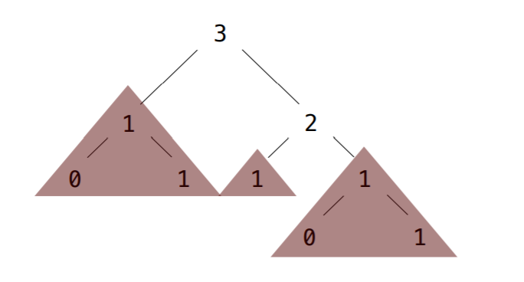
Pruning
Demo
Goal: Given a Tree, t, and a value x, remove each branch with label equal to x
prune(t, 1)

Slide 6
Interfaces

Slide 7
Interfaces
Describe how you can interact with an object without necessarily implementing it.
>>> s = 'Hi there!'
>>> print(s)
>>> 1 + 2
TypeError: unsupported operand type(s) for +: 'int' and 'int'
<string object at ...>
Hi there!
3

Slide 8
Magic Methods

Slide 9
Magic Methods
These are specially named methods that are callable outside the ordinary dot notation.
Example: __init__
class A:
def __init__(self, num):
self.num = num
specifies
>>> a = A(5)
Equivalent to:
a = A.__new__(A))
a.__init__(5)

Slide 10
str & repr

Slide 11
str
class A:
def __str__(self):
return 'A object'
specifies
>>> a = A()
>>> str(a)
'A object'
__str__ specifies what occurs when str is called on it
Used when calling print on an object
>>> a = A()
>>> print(a)
A object
Equivalent to:
a.__str__()

Slide 12
repr
class A:
def __repr__(self):
return 'A object'
specifies
>>> a = A()
>>> repr(a)
'A object'
__repr__ specifies what occurs when repr is called on it
Used when displaying an object in the interpreter
>>> a = A()
>>> a
A object
Equivalent to:
a.__repr__()

Slide 13
str vs repr
>>> class A:
... def __str__(self):
... return 'A object'
...
>>> a = A()
>>> print(a)
A object
>>> a
<__main__.A object at ...>
>>> class A:
... def __repr__(self):
... return 'A object'
...
>>> a = A()
>>> print(a)
A object
>>> a
A object

Slide 14
str vs repr
>>> class A:
... def __str__(self):
... return 'Hello!'
... def __repr__(self):
... return 'Goodbye!'
...
>>> a = A()
>>> print(a)
Hello!
>>> a
Goodbye!

Slide 15
Enhancing Linked Lists

Slide 16
repr for Linked Lists
>>> lnk = Link(1, Link(2, Link.empty))
>>> lnk
Link(1, Link(2))

Slide 17
str for Linked Lists
>>> lnk = Link(1, Link(2, Link.empty))
>>> print(lnk)
<1, 2>

Slide 18
equality
s == t
Equivalent to:
s.__eq__(t)

Slide 19
Sequences
Operation | Result
x in s , x not in s | Returns boolean representing membership
s + t | Concatenates two sequences
s * n , n * s | Concatenates n shallow copies
len(s) | Number of elements in sequence
s[i] | i’th item of sequence
s[i:j], s[i:j:k] | Slicing

Slide 20
membership
x in s, x not in s
Equivalent to:
s.__contains__(x)

Slide 21
concatenation
s + t
Equivalent to:
s.__add__(t)

Slide 22
repetition
s * n, n * s
Equivalent to:
s.__mul__(n)
s.__rmul__(n)

Slide 23
length
len(s)
Equivalent to:
s.__len__()

Slide 24
indexing
s[i]
Equivalent to:
s.__getitem__(i)

Slide 25
slicing
s[i:j], s[i:j:k]
Equivalent to:
s.__getitem__(slice(i,j))
s.__getitem__(slice(i,j,k))

